Slide 1



AAA Market Segmentation - Analysis & Recommendations
Ruben Rosa
March 2020
Notes:
https://pixabay.com/photos/new-york-skyline-new-york-city-city-668616/

Slide 2
02
The Problem
01
Overview
Agenda
Market Segmentation - Analysis & Recommendations
03
The Solution
04
The How
05
Findings & Actions

Slide 3

Overview
AAA was founded over 100 years ago, committed to serve you
Lobbying for driver and passenger rights, fair laws and safer vehicles
Grown to over 60 million members strong, while providing valuable membership services such as roadside assistance.
Additionally, broadened its horizons to include all types of travel-related services, as well as offer a variety of insurance and financial products and services.
Today's AAA is a national federation comprised of 25 individual clubs throughout the United States and Canada.

Slide 4

The Problem
AAA Northeast requires to provide better service to their members.
PROBLEM
PROBLEM
PROBLEM
What do the members really want?
What are the headaches?
How can I attract more members?
What are the profitable ones?
Are they cancelling? Why?
Am I offering the proper products and services
Am I targeting the right customers?

Slide 5
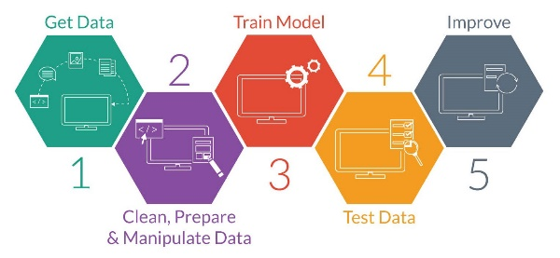

The Solution
From analytics to insights to actions
Benefits
Proper Classification
Clustering the offering
Prediction of Customer’s needs
Processing
ML
AAA Customer Data
ML
AI
AI
AI
ML
Actions to:
Reduce Membership Churn
Increase profitability
Anticipate needs by targeting the proper customers with the right products
Improve productivity
ML
Notes:
This Photo by Unknown Author is licensed under CC BY-SA-NC

Slide 6
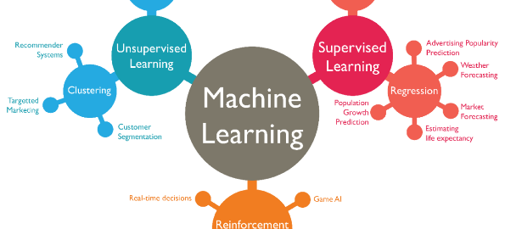




The How
01
Use a systematic approach – CRISP-DM to ensure valid outcomes
Analyze, understand and clean the data to ensure proper business understanding
02
03
Define features, prepare data and modeling
04
Evaluate, analyze results and improve models

Slide 7

The How
Performed Exploratory Data Analysis
Reduced / group several categories features
Performed Feature Engineering
Imbalance classification to balance classification
Analyze Up Sampling Minority Class and Down Sampling Majority Class and select 3 best models based on Baseline model performance
Perform correlation analysis and removed strong correlated features
Split Data in Train and Test for validation
Perform Grid Search of Hyperparamters to tune up models
Evaluate and Select two best model using unseen test data
Reduce Number of Features (using PCA and/ or SelectFromModel)
Build new model with new features
Final Outcomes and Results
Approach

Slide 8
Membership Churn
Findings and Recommendations

Slide 9
Target 1 -> Reduce Membership Churn
In Three Years
44%
+2,3k members have cancelled their membership
Profit Lost
30%
Around USD 440k profit lost
Causes
90%
Member issues (60%), payment issues (36%) and Data/AAA issues (5%).

Slide 10

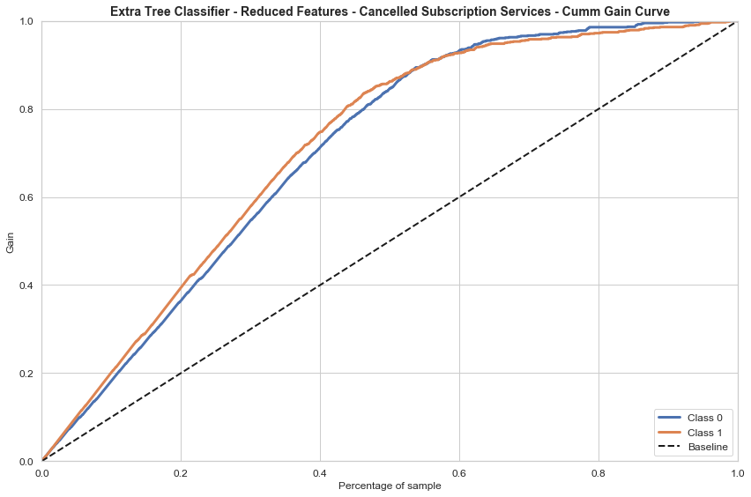
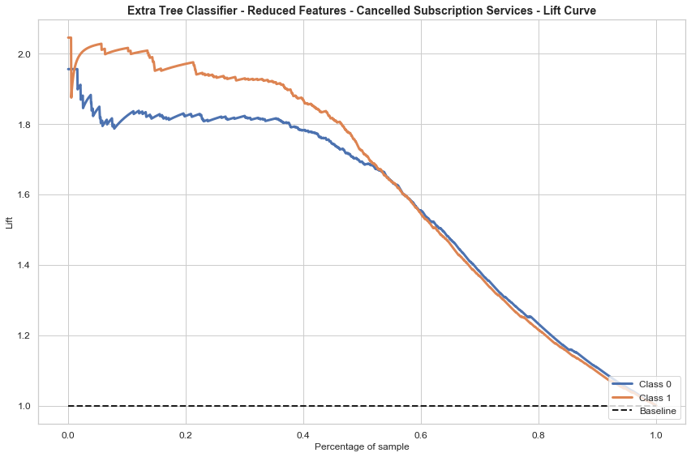
Model Prediction – Membership Churns
?
?
?
Main Significant Features
Length of Residence
Total Members in Household
Mean Total Calls per Vehicle Manufacturer
Members income (Above 100k)
Member Credit Ranges (Above 800+)
Education – Completed college
Baby boomers, Generation X & Post War
Do not use Financial Service (Mortgage and Credit Cards)
?
By targeting only 60% gets 90% + response rate
How powerful is our the predicting model?
Increase of productivity by using the model
(+4.5 times)

Slide 11

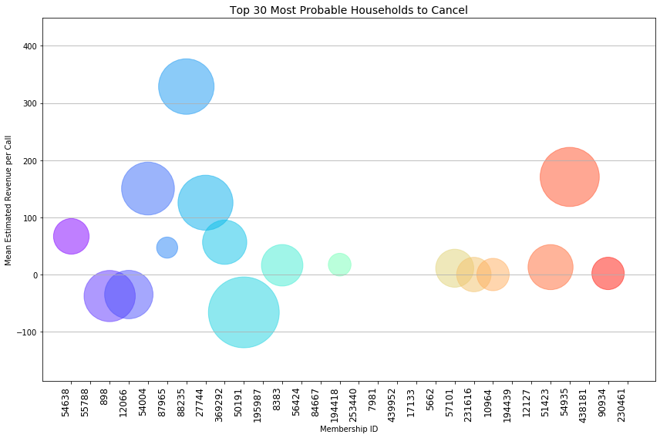
Model Prediction – Membership Churns
Size of Bubble = Mean AAA Cost
If Probability to Cancel Membership:
> 50%:
  -200 Potential Clients (↓5%)
  USD +60k in ↓ Revenue
> 40%:
  -480 Potential (↓ 13%)
  USD +80k in ↓ Revenue
> 30%:
  +780 Potential (↓ 20%)
  USD +150k in ↓ Revenue
> All:
  +3k Potential (↓ 20%)
  USD +1MM in ↓ Revenue
Pay extra attention

Slide 12

Model Prediction – Membership Churns
Target Offerings to Members
100%
85%
34%
27%
20%
19%
14%
9%
<1%
Target: Probability to Cancel => 50%
0%
Mean Likelihood
to use
(currently not using it):
Roadside
Insurance
Mortgage
Travel
ID Theft
Credit
Card
Deposit
Home
Equity

Slide 13
Customize Service Offerings
Findings and Recommendations

Slide 14

Auto Insurance
Services
Findings and Recommendations

Slide 15
Target 2 -> Customize Service Offerings to Members
Using Auto insurance
27%
+1.4k members contracted auto insurance services (Total 5,3k members)
Mean Member Costs
75%
No : USD 338
Yes : USD 591
Revenue No vs. Yes
227 vs 429
Mean AAA Costs
45%
No : USD 111
Yes : USD 162

Slide 16
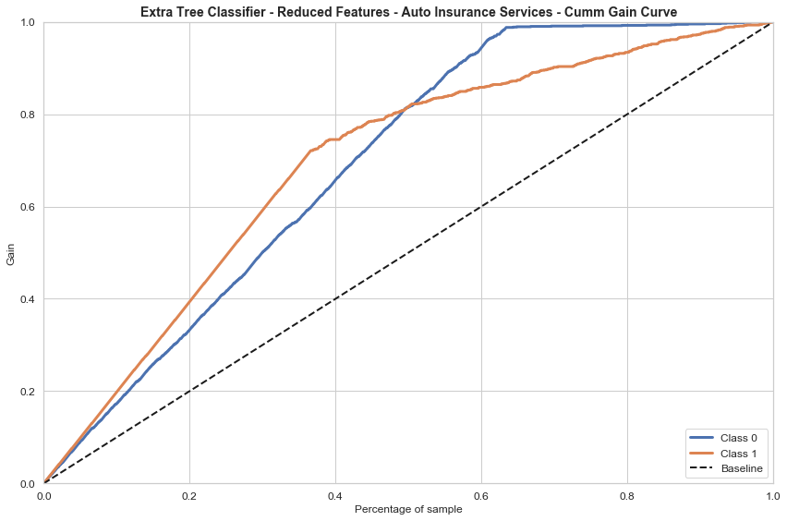
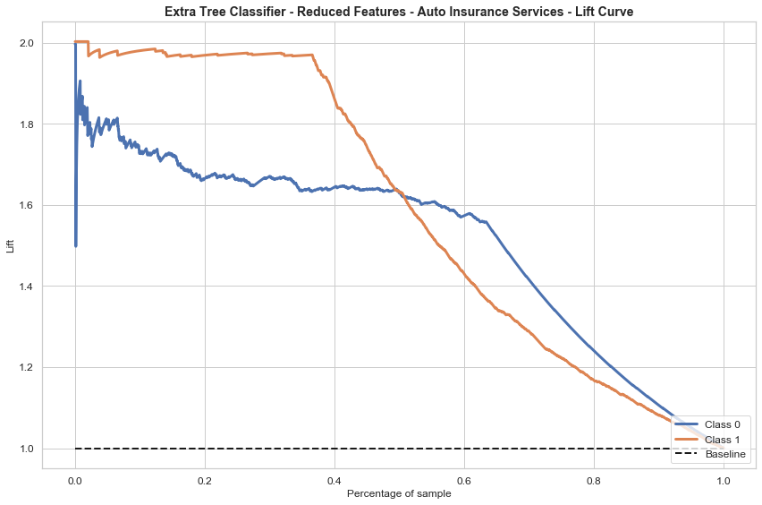
Model Prediction – Auto Insurance
?
?
Main Significant Features
Number of Children
Mean Total Calls and Mean Tow Miles
Consumer Score (Consumer Report Score)
Member Income (Above 100k or below 40k)
Member Credit Ranges (above 800 or below 700)
Education – Completed college
Baby boomers, Generation X & Gen Z
Do not use Financial Service (Mortgage and Credit Cards)
Member posses Plus and Premier Memberships
Number of members above 3
Occupation Group (Management or Retired)
?
?
By targeting only 60% gets 85% response rate
How powerful is our the predicting model?
Increase of productivity by using the model
(+3.3 times)

Slide 17
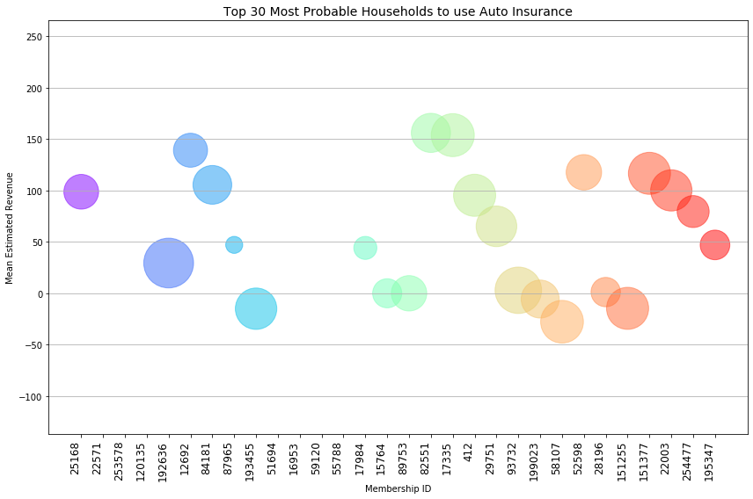
Model Prediction – Auto Insurance
Size of Bubble = Mean AAA Cost
If Probability to use Auto Insurance :
> 50%:
  +150 Potential New Clients (↑ 4%)
  ↑ USD +60k in Revenue
> 40%:
  +424 Potential New Clients (↑ 11%)
  ↑ USD +160k in Revenue
> 30%:
  +960 Potential New Clients (↑ 25%)
  ↑ USD +382k in Revenue
> All
  +1.4 Potential New Clients (↑ 36%)
  ↑ USD +622k in Revenue
Pay extra attention – increase revenue

Slide 18
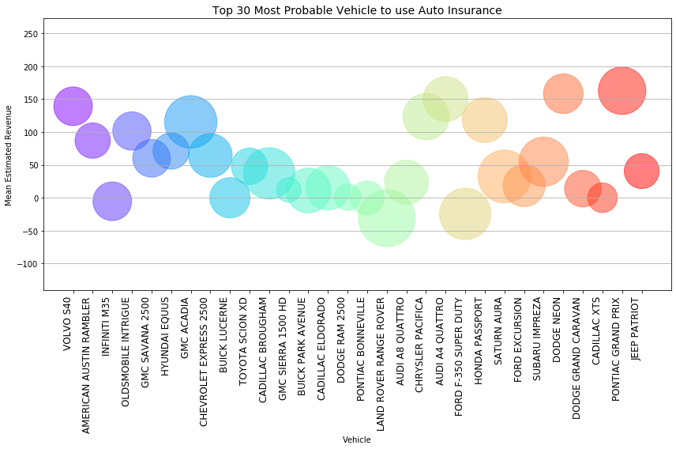
Model Prediction – Auto Insurance
If Probability to use Auto Insurance :
> 50%:
  +150 Potential New Clients (↑ 4%)
  ↑ USD +60k in Revenue
> 40%:
  +424 Potential New Clients (↑ 11%)
  USD +160k in ↑ Revenue
> 30%:
  +960 Potential New Clients (↑ 25%)
  ↑ USD +382k in ↑ Revenue
> All
  +1.4 Potential New Clients (↑ 36%)
  ↑ USD +622k in ↑ Revenue
Pay extra attention – increase revenue

Slide 19
Model Prediction – Auto Insurance
Target Offerings to Members
100%
81%
29%
28%
19%
16%
4%
<1%
Target: Probability to purchase Auto Insurance => 50%
0%
Mean Likelihood
to use
(currently not using it):
Roadside
Mortgage
ID Theft
Travel
Credit
Card
Deposit
Home
Equity

Slide 20

Travel
Services
Findings and Recommendations

Slide 21

ID Theft
Services
Findings and Recommendations

Slide 22

Credit Card
Services
Findings and Recommendations

Slide 23
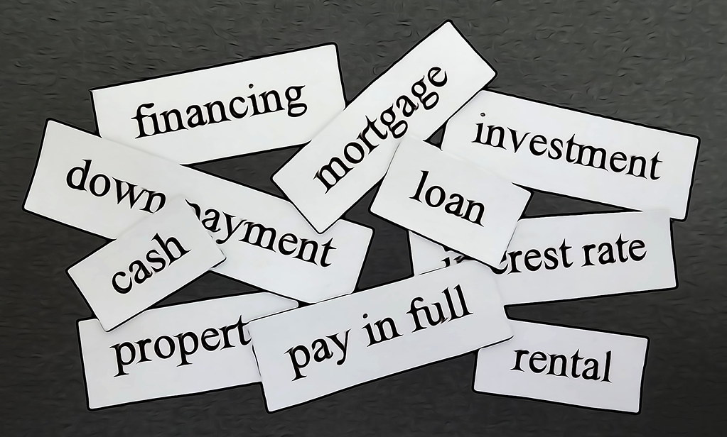
Financial
Services
This Photo by Unknown Author is licensed under CC BY
Findings and Recommendations

Slide 24
Costs and Revenues
Findings and Recommendations

Slide 25
THANK YOU
Ruben Rosa
March 2020

Slide 26

Backup Slides

Slide 27
Performed EDA
Reduced / group several categories features
Performed Feature Engineering
Imbalance classification
Analize Up Sampling Minority Class and Down Sampling Majority Class
Selected Over Sampling based on Baseline model performace
Selected RandomForest ExtraTreeClassifier and XGBoost Classifier
Perform Correlation analysis and removed strong correlated features
Split Samples in Train and Test for validation
Perform GridSearch of Hyperparamters
Evaluate and Select two best model – ExtraTreeClassifier and XGBoost Classifier
Reduce Number of Features using SelectFromModel
Build new model with new features
Final Outcomes
Approach

Slide 28
EDA & Feature Engineering approach

Slide 29
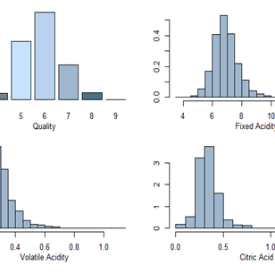
Exploratory Data Analysis
Findings and Actions
  Imbalance categories
    Up sample minority class
  A lot of missing data
    Filled them out as possible
    Classiffied as Unknown and dropped
  Gap between May/2017 and Octuber 2018
    After analysing the time series of the incidents, decided to use the previous period as the missing data.
    Required to properly estimate costs

Slide 30
Feature Engineering
Regroup:
  Income down to 3 from +15
  Tenures into 3 groups
  Credit Ranges down 3 groups from +8
  Race down to 5 groups from +15
  Cancel Reason down to 3 groups from +15
  Mosaic Global household down to 5 groups from +15
  Vehicle Manufaturer down to 3 groups from +15
  Occupation Group down to from groups from +15
  Total members inside a household created 5 big groups

Slide 31
Feature Engineering
New Features:
  Roadside Usage
    To predict its membership usage probability
  Customer_Cancellation
    to predict membership churn
  Active Expiration Date, Reinstate date, Cancel date, Date of birth, Call status recv date,
    Year – Month, Year, Year – Week, Week, Month
  Age in years
  Age Ranges - Generation
  Tenure date ranges
  Feature number of children to numeric
  Mean Tow miles per manufacturer
  Total Tow Miles per Manufacture
  Mean Cost per Vehicle Manufacturer
  Total Cost per Vehicle Manufacturer
  Vehicle (Manufacture plus model)
  Consumer Score per Manufacturer (Consumer Report Stats)

Slide 32
Membership Churn
Detail Analysis

Slide 33
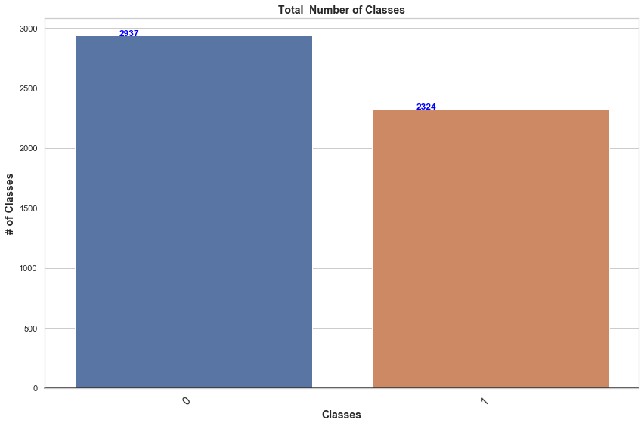
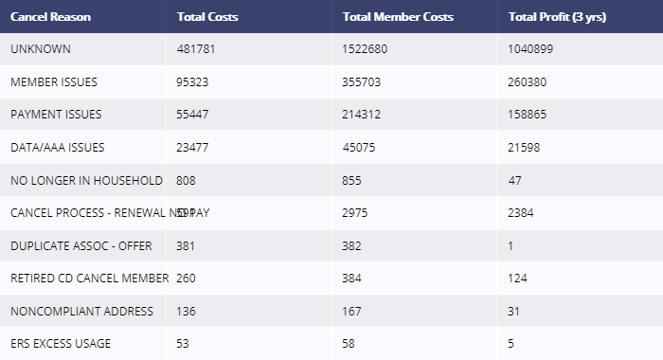
Total Members by Membership Status
Since 2014, around +2.3k members have cancelled their subscription
3 Main Causes:
  Member Issues
  Payment Issues
  Data/AAA Issues
Profit lost: USD 440k in 3 years
Payment Issues are: NON-PAYMENT, ERS DECLINE CC, BAD ADD SET BY PO ACS, BAD CHECKS
Member Issues are: DECEASED, NO LONGER DRIVING, MEMBERS REQUEST, CANCELLED DO NOT RENEW, TRANSFER MEMBER, DO NOT RENEW, MOVED OUT OF TERR, TRANSFER MEMBER SUSPEND, CANCELLED MBRS REQUEST, HEALTH ISSUE, NONCOMPLIANT AGE, PO RETURN
Data Issues are: DATA PROBLEM, DUP MEMBERSHIP, ERS CNCL MSHIP PROGRAM, MANAGEMENT REQUEST, CANCEL PROCESS - FUTURE CANCEL DNR

Slide 34
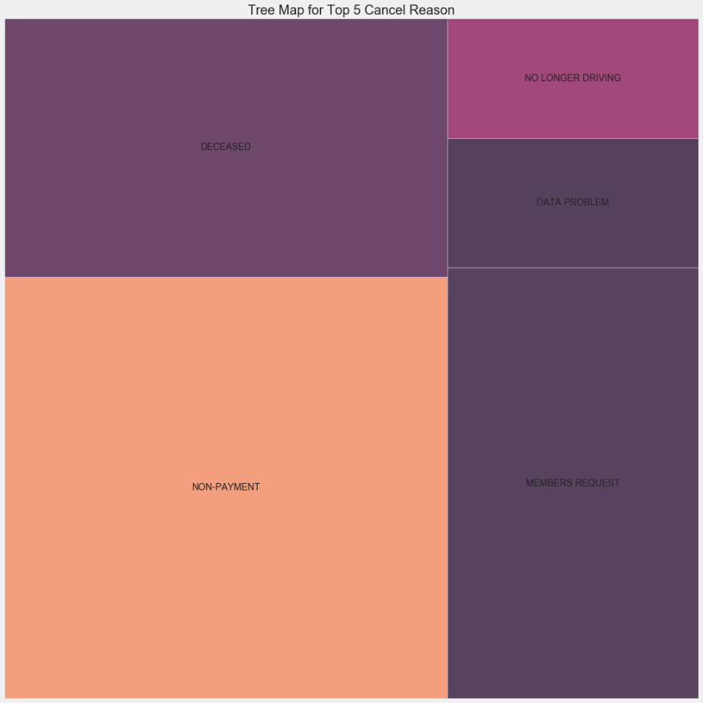
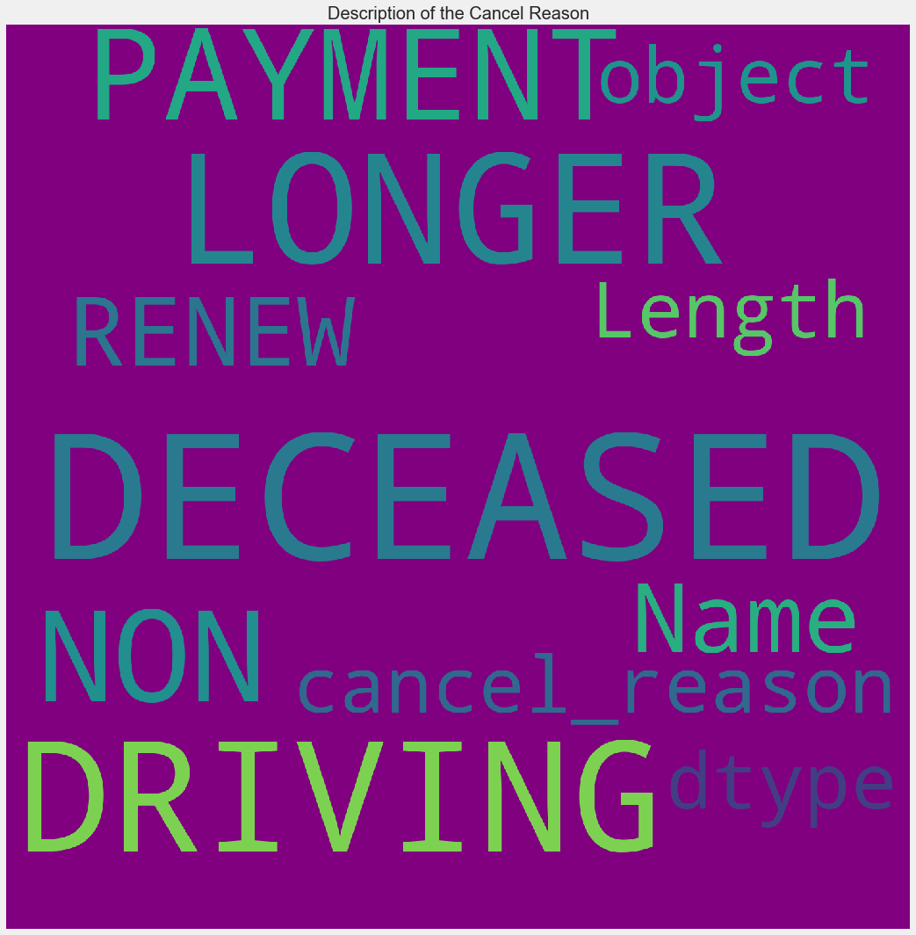
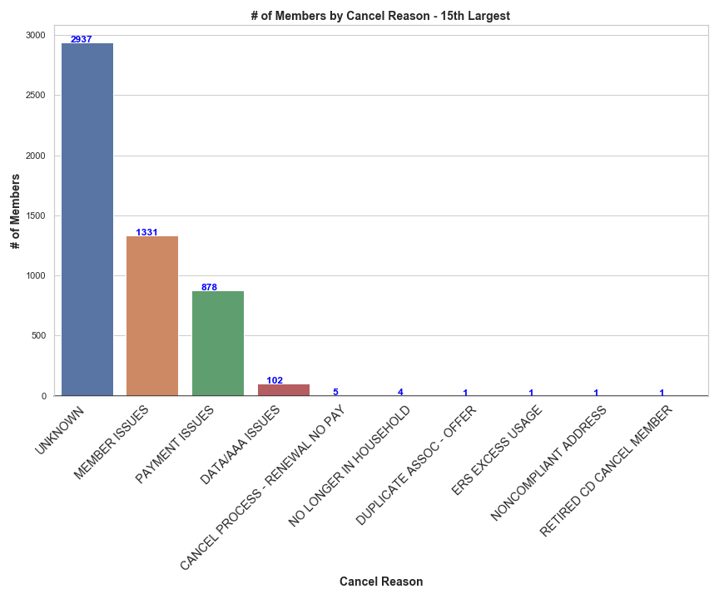
Total Members by Membership Status

Slide 35
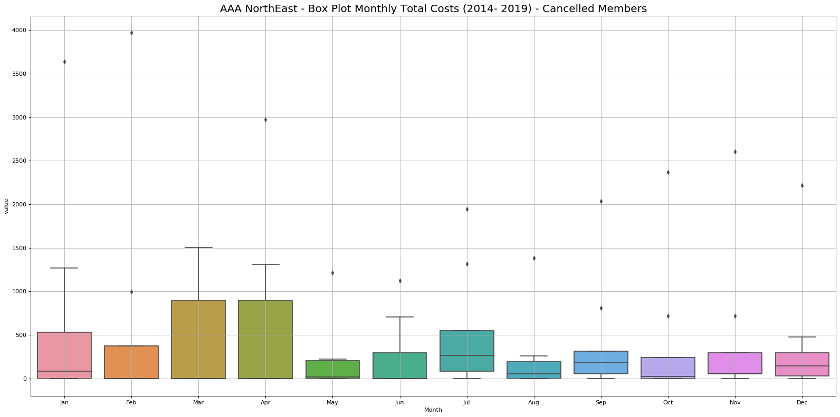
Total Costs by Cancel Date
Top 3 highest Months

Slide 36
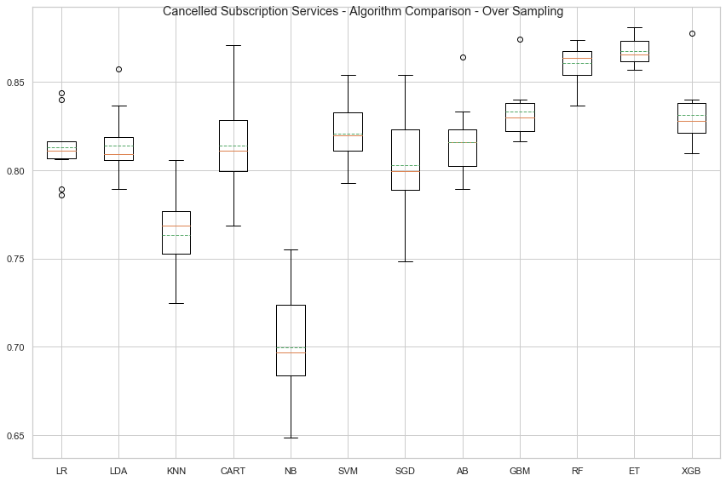
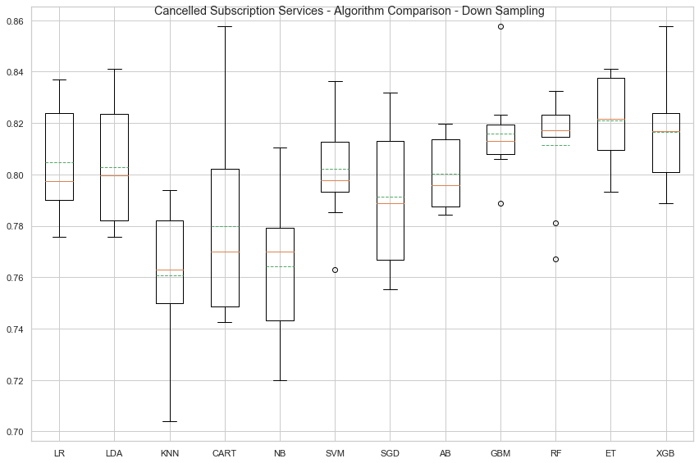
Baseline Models Comparison - Accuracy
Selected

Slide 37
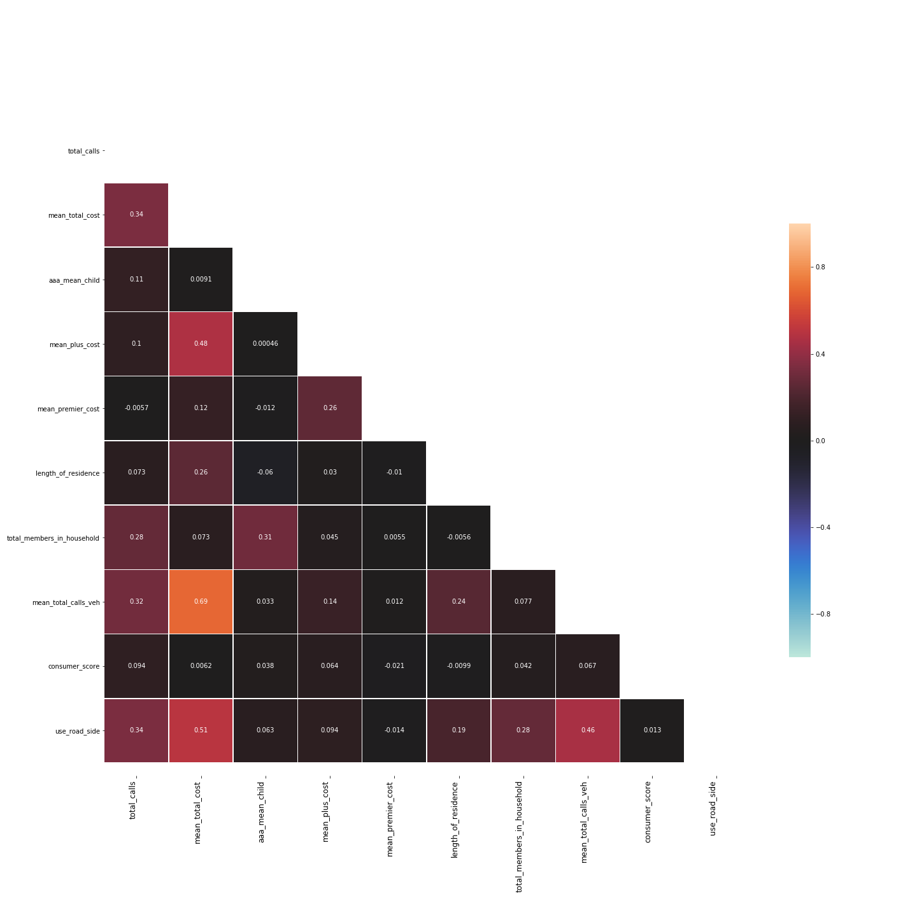
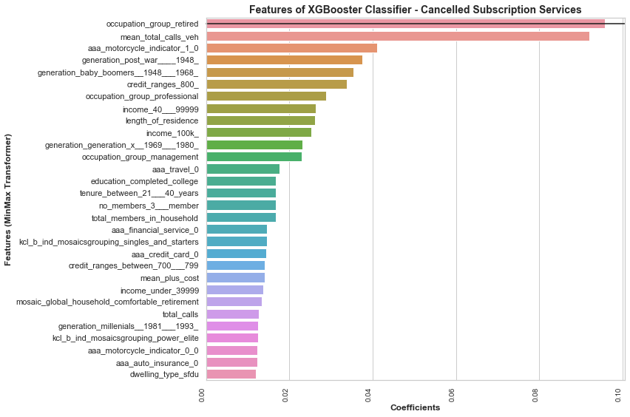
Correlation Analysis – Outcome (Threshold < 75%)

Slide 38

Membership Churn Prediction Model
Main Features
Significant Features
  Length of Residence
  Total Members in Household (specially 2 and above)
  Mean Total Calls per Vehicle Manufacturer
  Members income (Above 100k)
  Member Credit Ranges (Above 800+)
  Education – Completed college
  Generation
      Baby boomers
      Generation X
      Post War
  Do not use Financial Service (Mortgage and Credit Cards)
  Occupation Group
    Management
    Professional
    Retired
  Experian Mosaics Grouping
    Singles & Starters
  Tenure (between 21 & 40 years)
  Do not use travel services

Slide 39
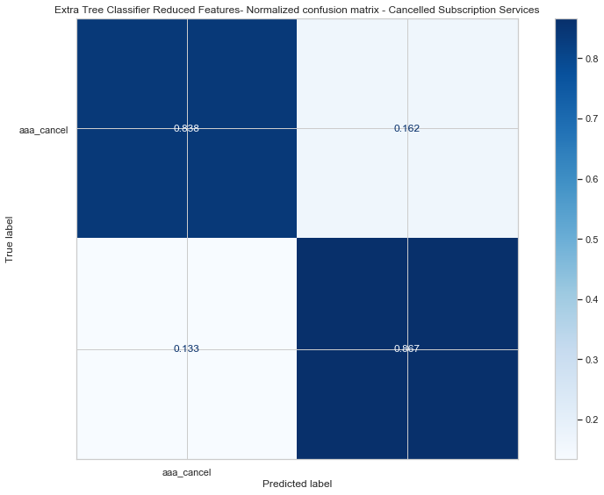
Membership Churn Model Performance Metrics
Extra Tree Classifier - Accuracy on training set : 0.971
Extra Tree Classifier - Accuracy on test set : 0.849
Extra Tree Classifier - Precision : 0.832
Extra Tree Classifier - Recall : 0.865
Extra Tree Classifier - F-measure : 0.848
Extra Tree Classifier - Log-Loss : 5.225
Extra Tree Classifier - Cross Entropy Loss : 0.762
Extra Tree Classifier - No Skill - ROC AUC : 0.500
Extra Tree Classifier - ROC AUC : 0.918
Extra Tree Classifier - Cross Validation Accuracy : 0.820 (+/- 0.036)

Slide 40
Auto Insurance
Services
Findings and Recommendations

Slide 41
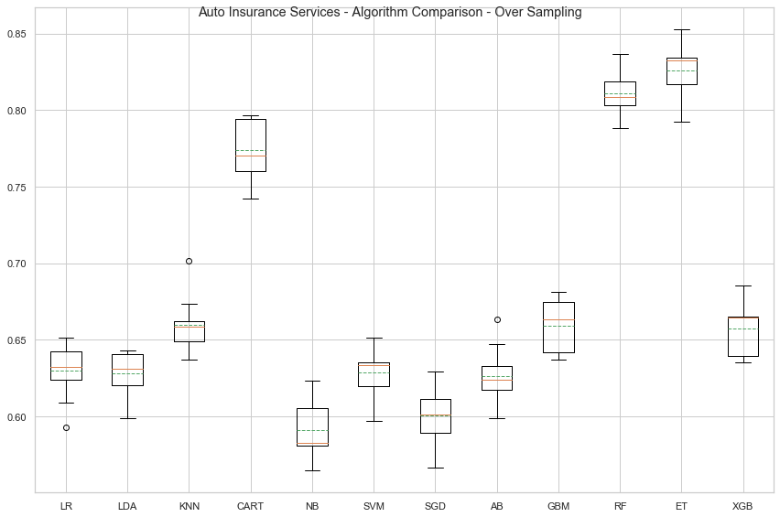
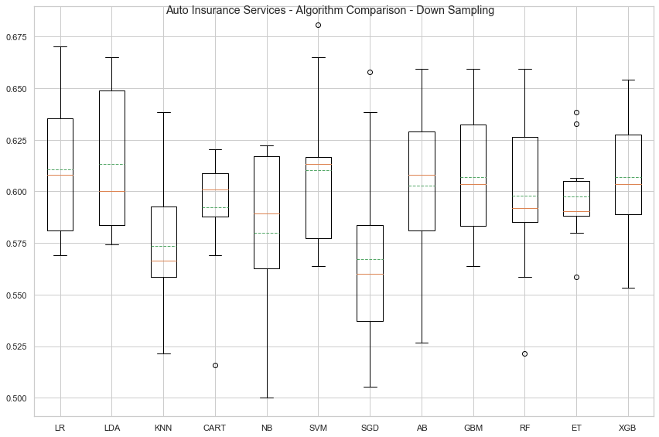
Baseline Models Comparison - Accuracy
Selected

Slide 42
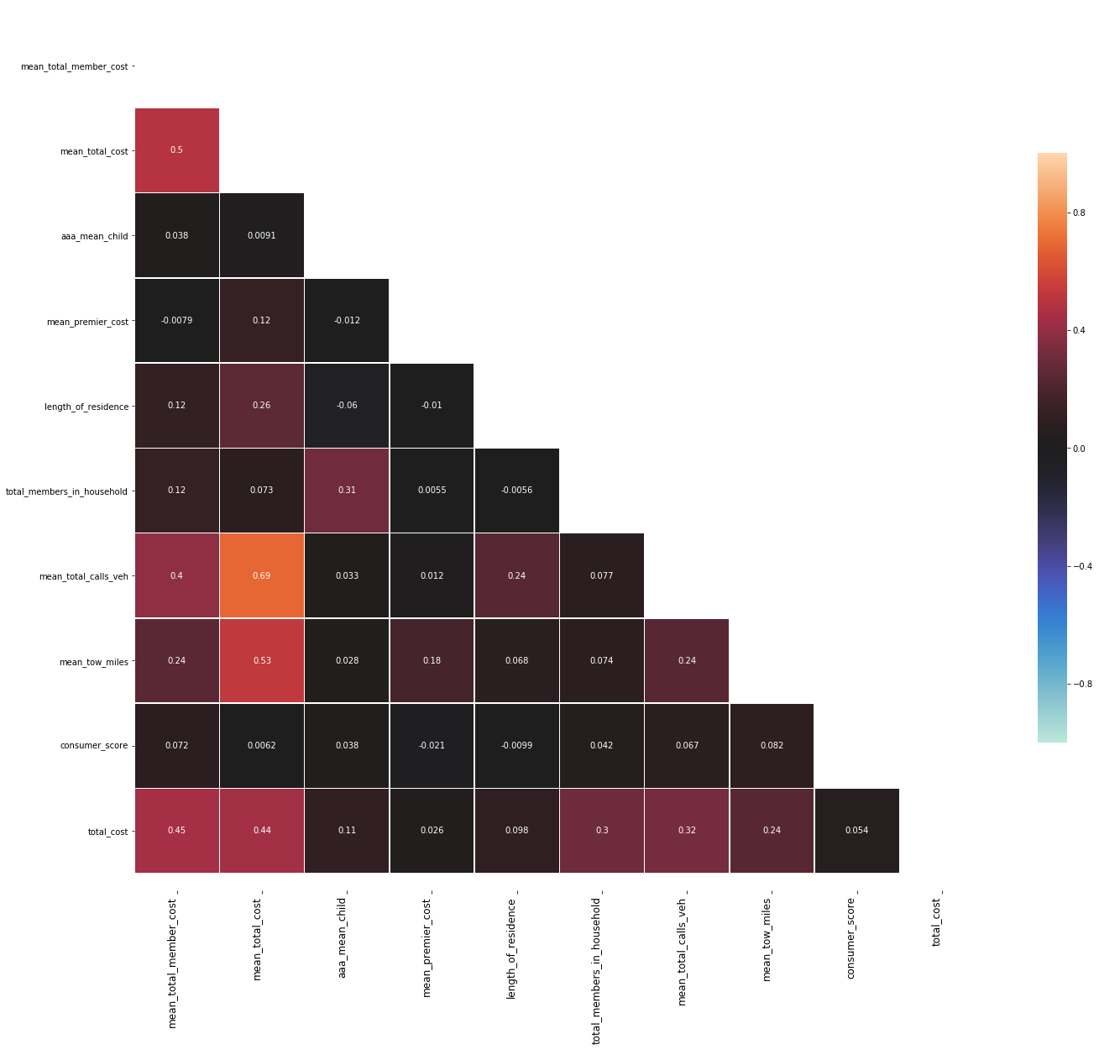
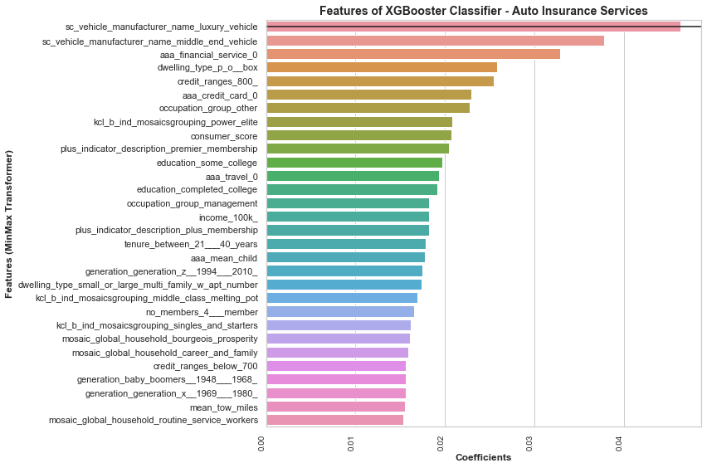
Correlation Analysis – Outcome (Threshold < 75%)

Slide 43
Auto Insurance Prediction Model
Main Features
Significant Features
  Number of Children
  Mean Total Calls and Mean Tow Miles
  Consumer Score (Consumer Report Score)
  Member Income (Above 100k or below 40k)
  Member Credit Ranges (above 800 or below 700)
  Education – Completed college
  Baby boomers, Generation X & Gen Z
  Do not use Financial Service (Mortgage and Credit Cards)
  Member posses Plus and Premier Memberships
  Number of members above 3
  Occupation Group (Management or Retired)
  Experian Mosaic grouping
  Dwelling type
  No Travel
  Experian Global Mosaic
  Tenure

Slide 44
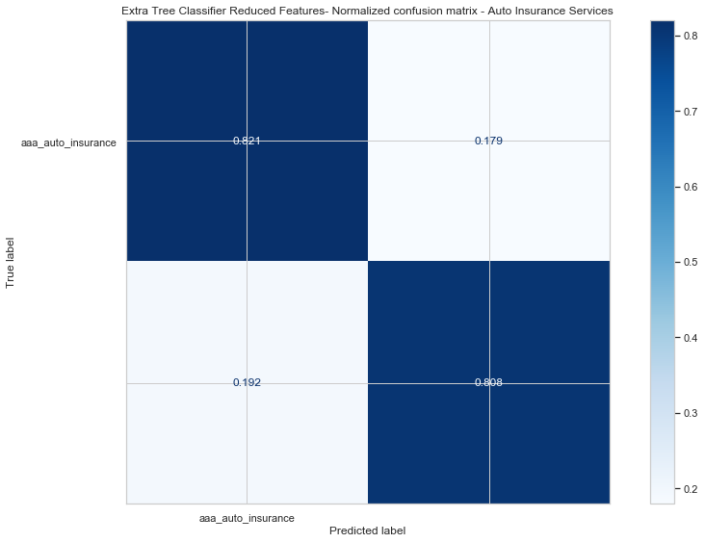
Auto Insurance Model Performance Metrics
Extra Tree Classifier - Accuracy on training set : 0.950
Extra Tree Classifier - Accuracy on test set : 0.814
Extra Tree Classifier - Precision : 0.818
Extra Tree Classifier - Recall : 0.808
Extra Tree Classifier - F-measure : 0.813
Extra Tree Classifier - Log-Loss : 6.411
Extra Tree Classifier - Cross Entropy Loss : 1.103
Extra Tree Classifier - No Skill - ROC AUC : 0.500
Extra Tree Classifier - ROC AUC : 0.885
Extra Tree Classifier - Cross Validation Accuracy : 0.696 (+/- 0.037)

